Slide 1



Advanced Text Generation
Techniques and Tools
Chapter 7

Slide 2


LangChain framework
LangChain is a complete framework for using LLMs. It has modular components that can be chained together to allow for complex LLM systems.

Slide 3
Model I/O: Loading Quantized Models with LangChain
Attempting to represent pi with float 32-bit and float 16-bit representations. Notice the lowered accuracy when we halve the number of bits.
Notes:
A GGUF model represents a compressed version of its original counterpart through a method called quantization, which reduces the number of bits needed to represent the parameters of an LLM.
Quantization reduces the number of bits required to represent the parameters of an LLM while attempting to maintain most of the original information. This comes with
some loss in precision but often makes up for it as the model is much faster to run, requires less VRAM, and is often almost as accurate as the original.

Slide 4
Chains: Extending the Capabilities of LLMs
A single chain connects some modular component, like a prompt template or external memory, to the LLM.
Notes:
Chains not only allow for extending the capabilities of LLMs but also for multiple chains to be connected together.
The most basic form of a chain in LangChain is a single chain. Although a chain can take many forms, each with a different complexity, it generally connects an LLM with
some additional tool, prompt, or feature. This idea of connecting a component to an LLM.

Slide 5
A Chain with Multiple Prompts
With sequential chains, the output of a prompt is used as the input for the next prompt.
Notes:
This process of using multiple prompts is an extension of our previous example. Instead of using a single chain, we link chains where each link deals with a specific
subtask.

Slide 6
Multiple prompts
The output of the title prompt is used as the input of the character prompt. To generate the story, the output of all previous prompts is used.

Slide 7
Memory: Helping LLMs to Remember Conversations
An example of a conversation between an LLM with memory and without memory.
Notes:
When we are using LLMs out of the box, they will not remember what was being said in a conversation. You can share your name in one prompt but it will have forgotten
it by the next prompt.
we will go through two common methods for helping LLMs to remember conservations:
• Conversation buffer
• Conversation summary

Slide 8
Conversation Buffer
We can remind an LLM of what previously happened by simply appending the entire conversation history to the input prompt.
Notes:
One of the most intuitive forms of giving LLMs memory is simply reminding them exactly what has happened in the past.
In LangChain, this form of memory is called a ConversationBufferMemory. Its implementation requires us to update our previous prompt to hold the history of
the chat.
One method of minimizing the context window is to use the last k conversations instead of maintaining the full chat history. In LangChain, we can use Conversation
BufferWindowMemory to decide how many conversations are passed to the input prompt

Slide 9
Conversation Summary
Instead of passing the conversation history directly to the prompt, we use
another LLM to summarize it first.
Notes:
This summarization process is enabled by another LLM that is given the conversation history as input and asked to create a concise summary. A nice advantage of using an
external LLM is that we are not confined to using the same LLM during conversation.

Slide 10
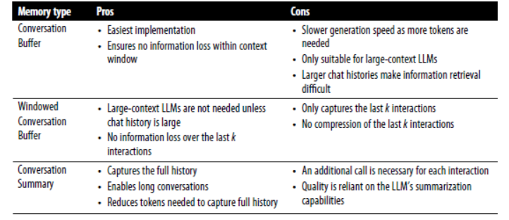
The pros and cons of different memory types.

Slide 11
Agents:
Giving LLMs the ability to choose which tools they use for a particular problem results in more complex and accurate behavior.
Notes:
One of the most promising concepts in LLMs is their ability to determine the actions they can take. This idea is often called agents, systems that leverage a language model to determine which actions they should take and in what order.
In other words, agents that make use of LLMs can be powerful general problem solvers. Although the tools they use are important, the driving force of many agent-based
systems is the use of a framework called Reasoning and Acting (ReAct1).

Slide 12
ReAct
An example of a ReAct prompt template.
Notes:
ReAct is a powerful framework that combines two important concepts in behavior: reasoning and acting.
ReAct merges these two concepts and allows reasoning to affect acting and actions to affect reasoning. In practice, the framework consists of iteratively following these
three steps:
• Thought
• Action
• Observation

Slide 13
Two cycles in a ReAct pipeline
An example of two cycles in a ReAct pipeline.
Notes:
An example of a complex prompt with many components.

Slide 14










TYPES OF AI
NARROW AI
GENERAL AI
SUPER AI
Narrow AI is designed to perform a specific task
General AI can perform any intellectual task that a human can
Super AI is hypothetical and would surpass human intelligence

Slide 15





HISTORY OF AI
The Dartmouth Conference, where the term "artificial intelligence" was first coined and AI was established as a field of research.
1956
The first AI system that could understand and respond to natural language was created by Terry Winograd, which marked a major step forward in natural language processing.
1974
IBM's Deep Blue defeated the world chess champion Garry Kasparov, demonstrating that machines could surpass human intelligence in specific domains.
1997
The emergence of deep learning led to breakthroughs in computer vision, speech recognition, and natural language processing.
2012

Slide 16



IN FINANCE
75%
12,000
50%
people said that AI has improved their decision-making process.
Morgan Chase used AI to analyze 12,000 commercial loan agreements in seconds
The use of AI in fraud detection has led to a 50% reduction in false positives

Slide 17








IN MANUFACTURING
Item 2
Item 3
12
10
8
6
4
2
0
2015
2016
2017
2018
2019
2020
2021

Slide 18








IN TRANSPORTATION
REDUCE 20% FUEL CONSUMPTION
REDUCE 30% MAINTENANCE COSTS
Self-driving trucks powered by AI have been shown to reduce fuel consumption by up to 20%, saving companies thousands of dollars per year.
AI-powered predictive maintenance can reduce maintenance costs by up to 30%, and increase vehicle reliability and uptime.

Slide 19






03
SOCIAL IMPLICATIONS
Explores the broader impact of AI beyond specific industries or applications. Considers ethical and societal implications such as job displacement, bias, privacy concerns, and potential impacts on democracy and human rights. Encourages a critical and thoughtful approach to AI development and deployment, taking into account the potential risks and benefits to individuals and society as a whole.

Slide 20




AI AND JOBS
JOBS AT HIGH RISK
JOBS AT SIGNIFICANT RISK
14%
32%

Slide 21



AI ETHICS
81%
People believe that companies should prioritize ethical considerations
63%
Were concerned about the ethical implications of the AI system

Slide 22
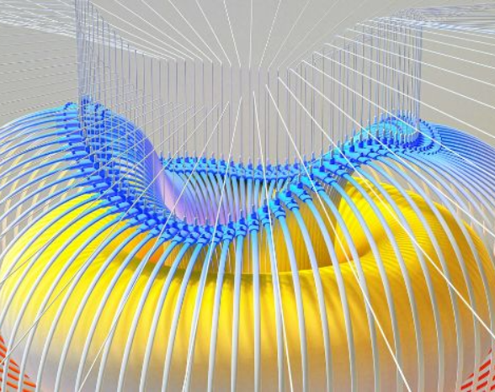

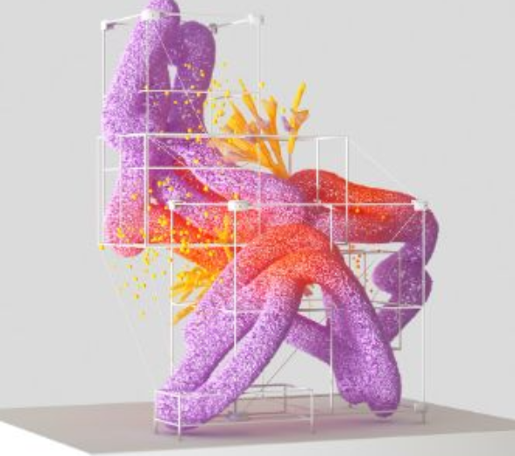

AI AND PRIVACY
A survey by Pew Research Center found that 64% of Americans are concerned about the way that companies are using their data, and 81% feel that they have little or no control over the data that companies collect about them.
20%
55%
The EU's GDPR includes provisions for ensuring that individuals have the right to access and control their personal data, including data that is processed using AI systems.

Slide 23



AI AND SOCIETY
Discusses the broader societal implications of AI, including its impact on job displacement, inequality, and social norms. This section aims to provide a comprehensive understanding of the ways in which AI is shaping our society and the challenges that need to be addressed.
04

Slide 24


THE RISE OF POWERFUL AI WILL BE EITHER THE BEST OR THE WORST THING EVER TO HAPPEN TO HUMANITY. WE DO NOT YET KNOW WHICH.
STEPHEN HAWKING

Slide 25








THANK YOU FOR
CHOOSING EATEMP
We offer free and high-quality slides templates for your presentations. We appreciate you choosing us and hope our templates have been helpful.
As a new website, we rely on your support to grow, so please help us by sharing our site with your friends and colleagues.
eatemp._
@eatemp
eatempofficial
@eatemp.official

